Slide 1
TITLE : "FOOT STEP POWER GENERATION"
K.Rishitha [23UP1A0532]
G.Akshaya [23UP1A0525]
A .pranavi[23UP1A0505]

Slide 2
INTRODUCTION
Foot step power generation harnesses the energy generated by people’s foot steps to produce electricity.
This concept involves placing sensors or piezo electric materials on the floor that can convert mechanical pressure from foot steps into an electrical energy.
The generated electricity can be used for charging the smart electronic devices.

Slide 3
ABSTRAT
This project presents the design and implementation of footstep electrical power generation .
Man has needed and used energy at an increasing rate for the well-being.
The generator aims to utilizes the kinetic energy generated by human footsteps and converts it into electrical energy.
This system consists of piezoelectric sensors strategically placed under awalking sureace which generate voltage pulses upon compression.
These pulses are processed by an arduino board enabling the conversion of mechanical energy into electrical energy.

Slide 4
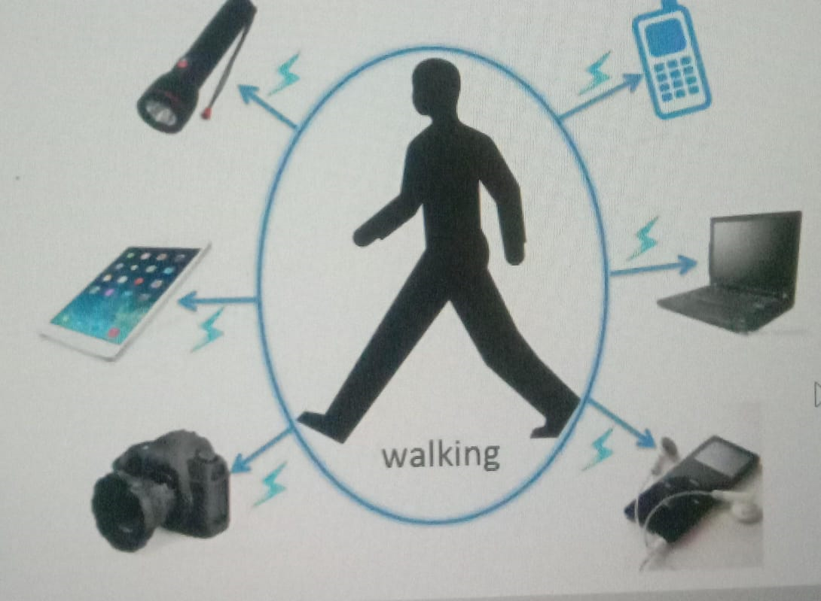
EXISTING PROBLEM
Day by day , the population of the country is increasing and the requirement for the electricity is also increasing.
At the same time the wastage of energy also increased in many ways.
As technology is developed and the use of gadgets ie electronic devices
also increased.

Slide 5
DISADVANTAGES
Due to the over usage of electronic gadgets the electricity is wasted
Because of this reason ,the future generations will suffer
And also the energy is wasted due to human locomotion in manyways
To overcome this problem the energy wastage can be converted to usable form...

Slide 6
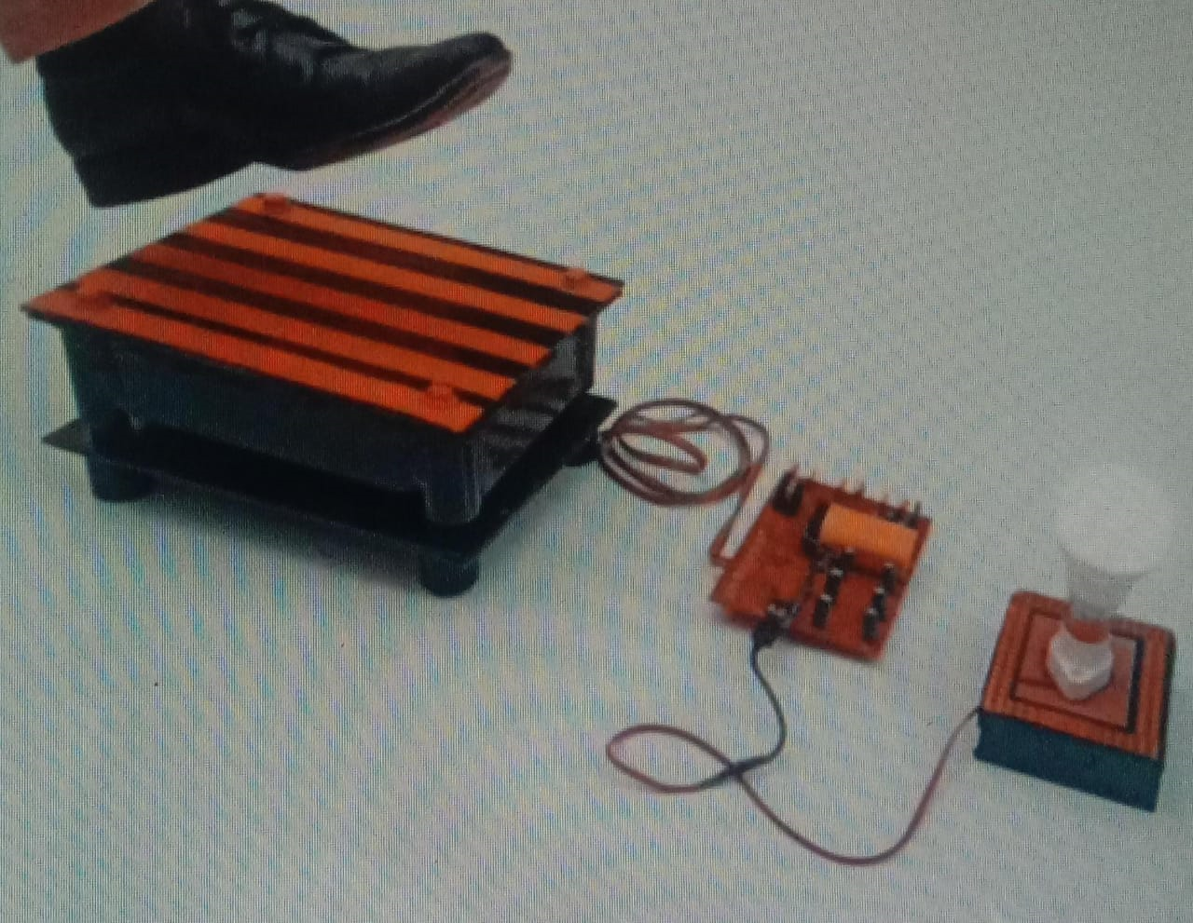
PROPOSED SYSTEM
THIS PROJECT IS USED TO GENERATE VOLTAGE USING FOOTSTEP FORCE.
ENERGY OF HUMAN LOCOMOTION CAN BE CONVERTED TO ELECTRICAL ENERGY.

Slide 7
ADVANTAGES
THIS PROJECT IS VERY USEFUL IN PUBLIC PLACES LIKE BUS STANDS, THEATERS,RAILWAY STATIONS,SHOPPING MALLS ETC.
THESE SYSTEMS ARE PLACED IN PUBLIC PLACES WHERE PEOPLE WALK AND THE SYSTEM GENERATES VOLTAGE ON EVERY STEP.
IN ANOTHER WAY,WE ARE ALSO SAVING NATURAL ENERGY RESOURCE.

Slide 8
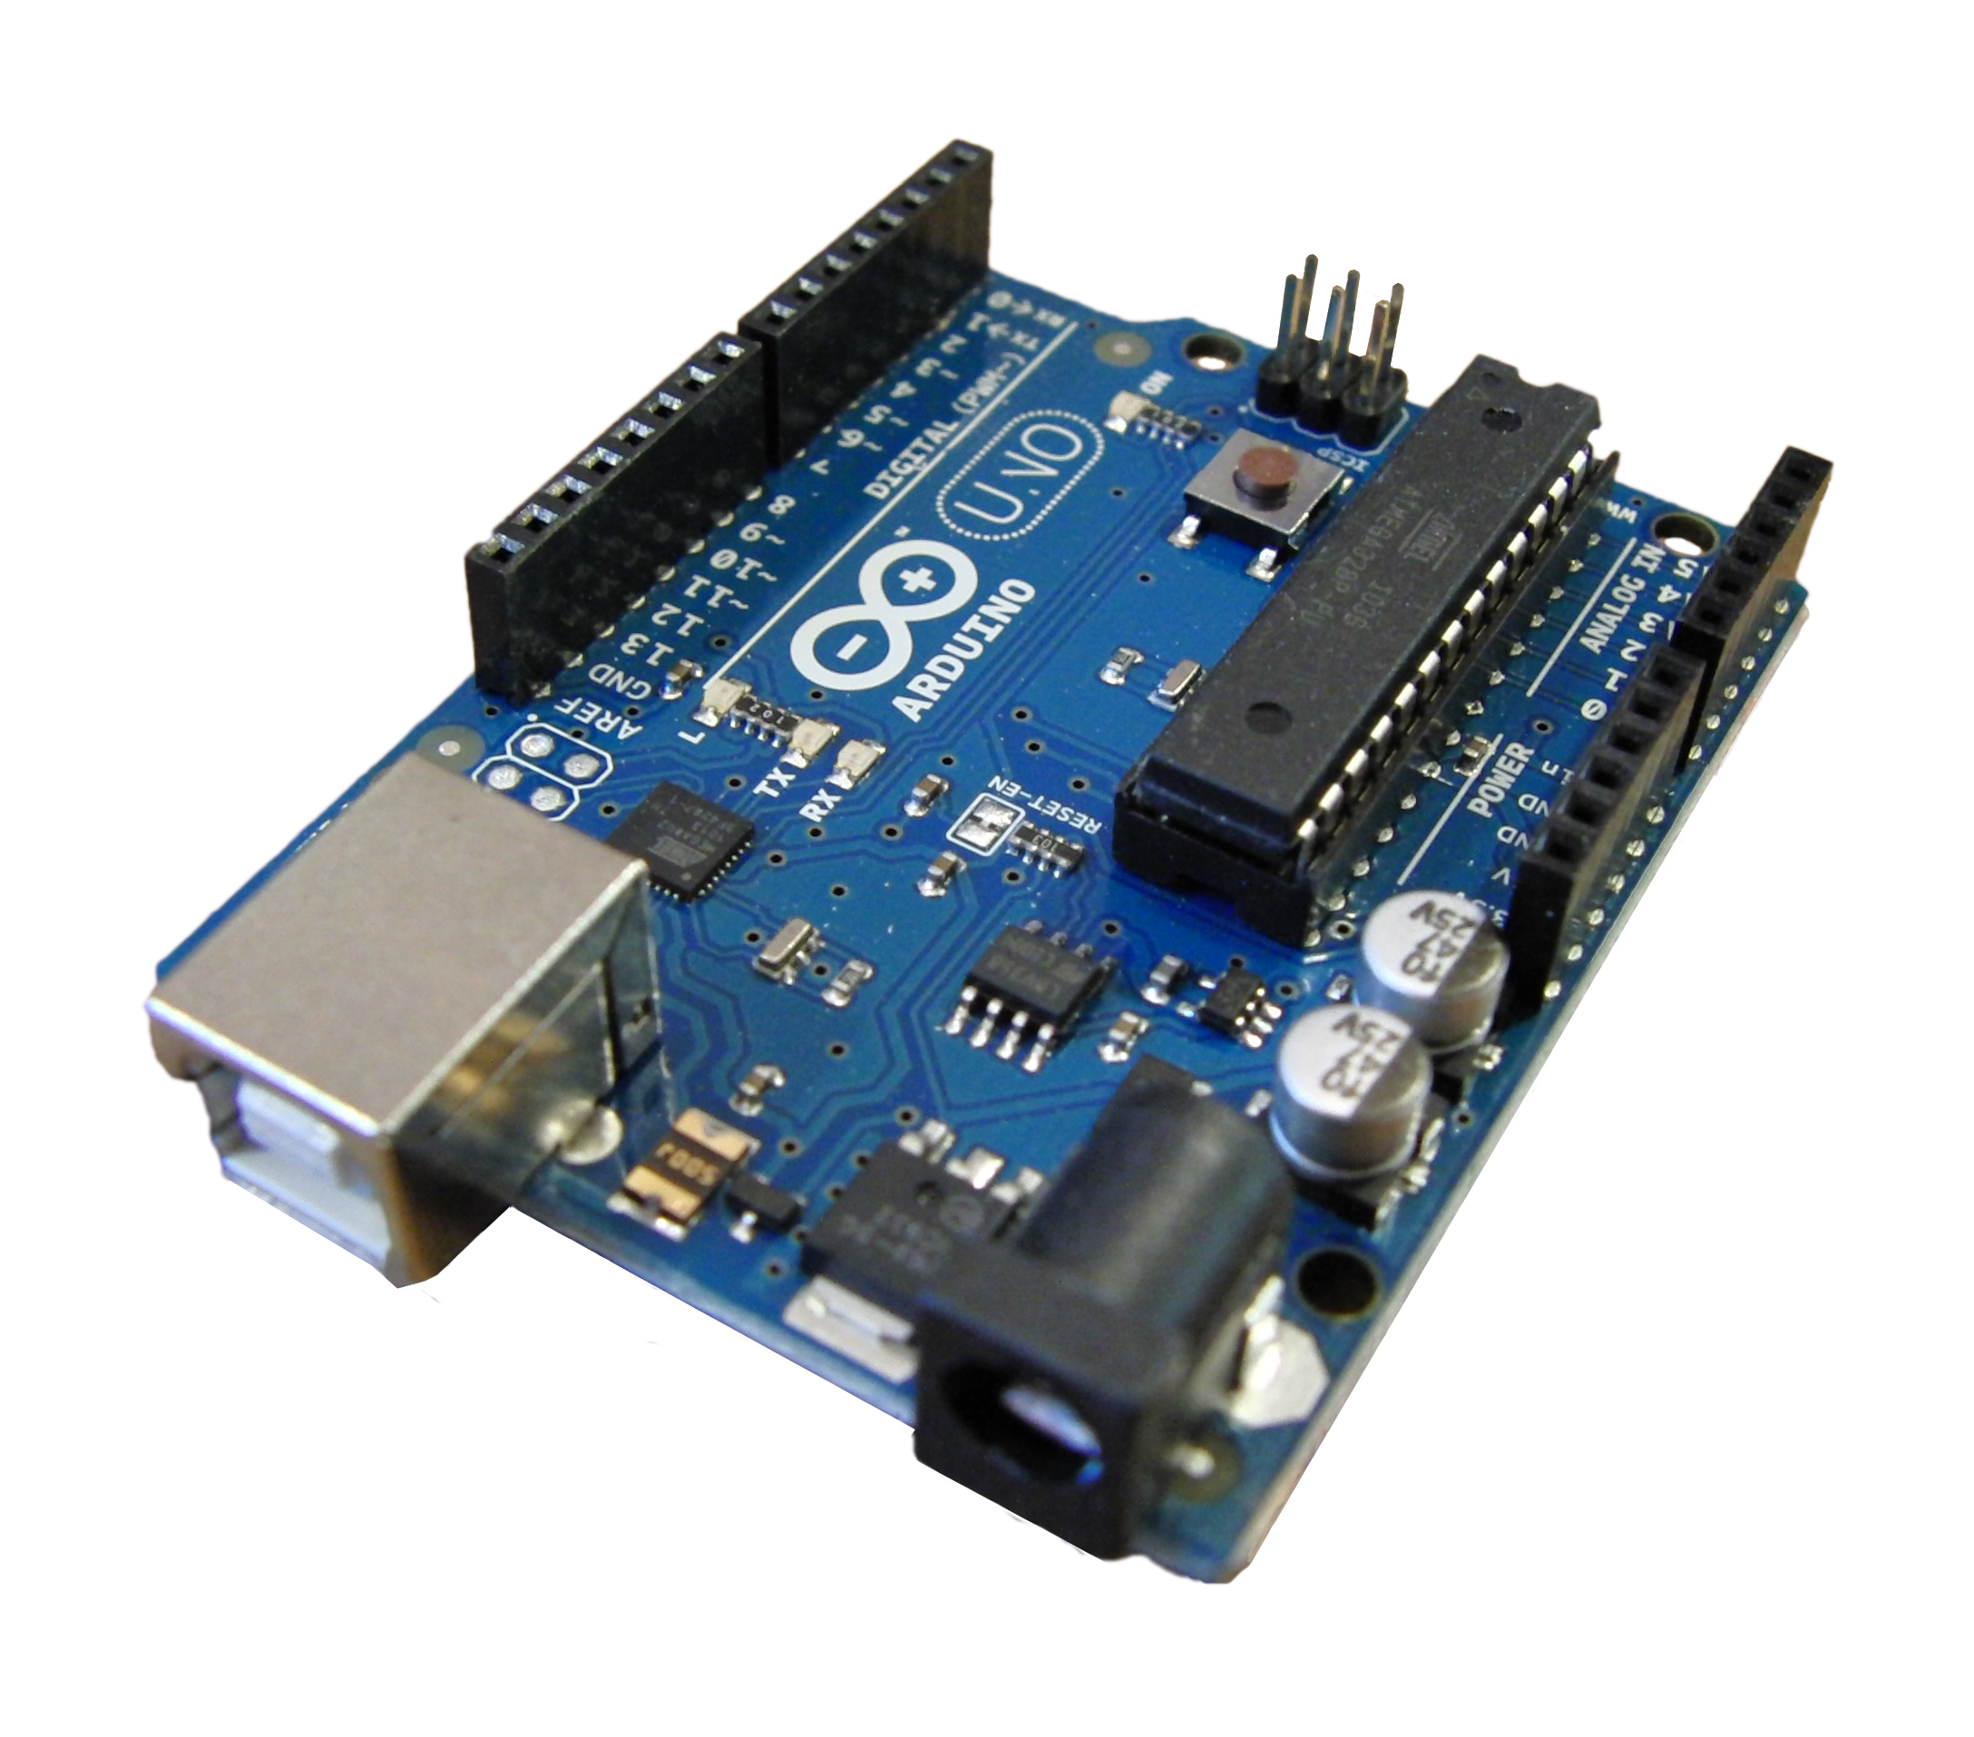
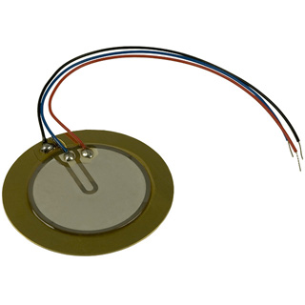
HARDWARE COMPONENTS
1.Arduino UNO:
The Arduino Uno is a versatile microcontroller board enabling the creation and control of electronic projects.
It runs code, or sketches, guiding the ATmega328P microcontroller to interact with connected components.
2.PIEZOELECTRIC SENSORS:
Piezoelectric sensors convert mechanical stress into electrical signals, detecting changes in pressure, acceleration, or force. They're widely used in applications like industrial machinery monitoring and medical devices, providing precise measurements through voltage generated in response to mechanical deformation.

Slide 9
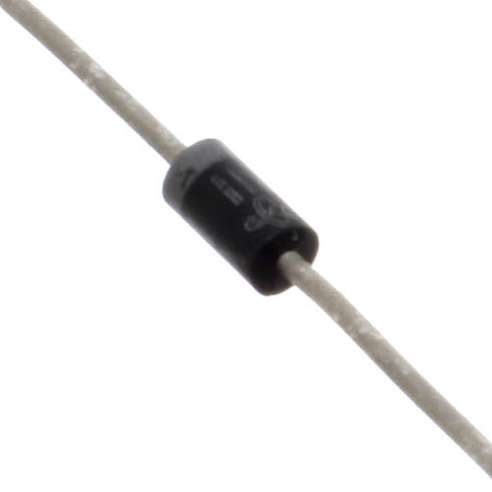
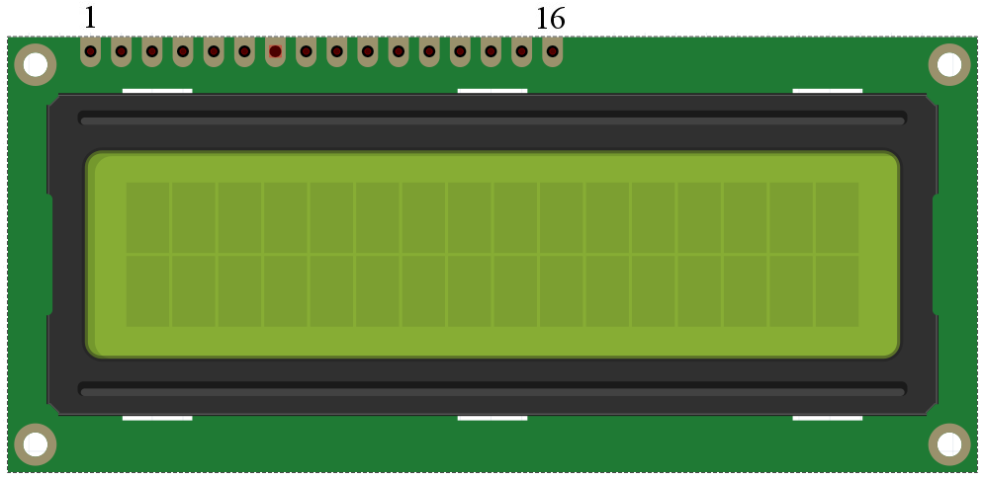
3.Diode:
A diode in an IoT project acts like a one-way street for electricity. It allows the current to flow in one direction but blocks it from going the other way. This helps control the flow of electricity and protect the components in the project
4.16*2 LCD:
A 16x2 LCD display refers to a liquid crystal display with 16 columns and 2 rows of characters, allowing the display of 32 characters at a time. These displays are commonly used in electronic projects and devices for presenting information such as text or simple graphics.

Slide 10
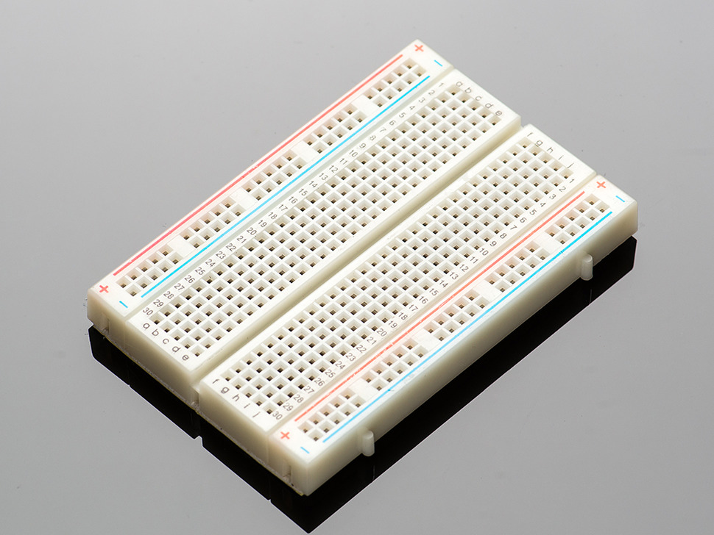
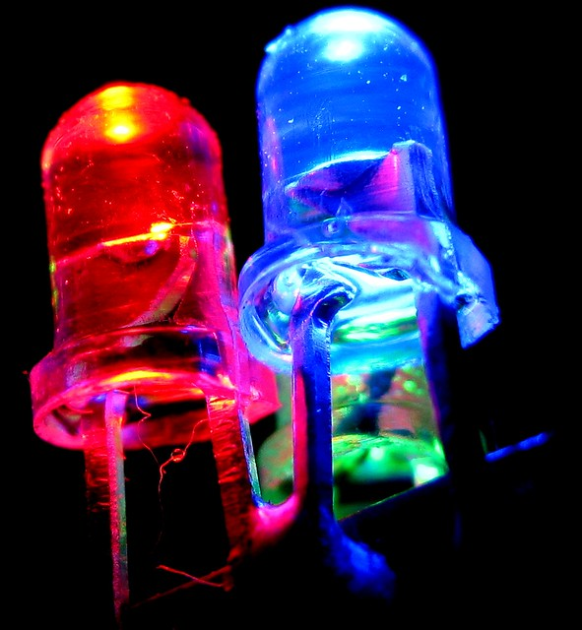
5.Breadboard:
A breadboard is used to make up temporary circuits for testing or to try out an idea. No soldering is required so it is easy to chante connections and replace components. Parts are not damaged and can be re-used afterwards.
6.LED:
It is a small component that emits light when electricity passes through it. It's used for indicating status or providing visual feedback. You can control its brightness or make it blink using a microcontroller. LEDs are popular because they're energy-efficient and come in different colors and sizes.

Slide 11
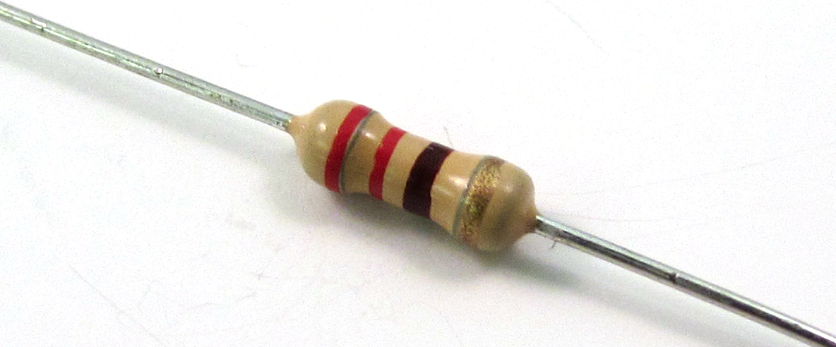
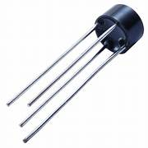
7.Resistor:
Resistors play a crucial role in electronic circuits by limiting the flow of electric current. They help control voltage levels, protect components, and ensure proper signal strength. Resistors are essential for designing efficient and reliable IoT devices, contributing to overall functionality and stability in electronic systems.
8.Bridge Rectifier:
A Bridge rectifier is a type of circuit that converts alternating current (AC) into direct current (DC). It's like a power converter for the electrical energy used in the project.
The bridge rectifier consists of four diodes arranged in a specific configuration. These diodes work together to rectify the AC voltage, meaning they convert it into a pulsating DC voltage.

Slide 12
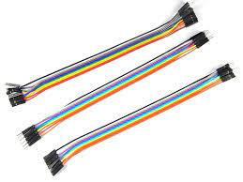
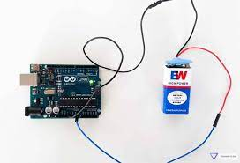
9.Jumper Wires:
Jumper wires are simply wires that have connector pins at each end, allowing them to be used to connect two points to each other without soldering. Jumper wires are typically used with breadboards and other prototyping tools in order to make it easy to change a circuit as needed.
10.Power Supply:
A power supply is a device that provides electrical energy to other devices. It converts input power, often from an electrical outlet, into the specific voltage and current needed to operate electronic components. Power supplies are crucial for the proper functioning of various electronic devices, ensuring they receive the right power to operate efficiently and safely.

Slide 13
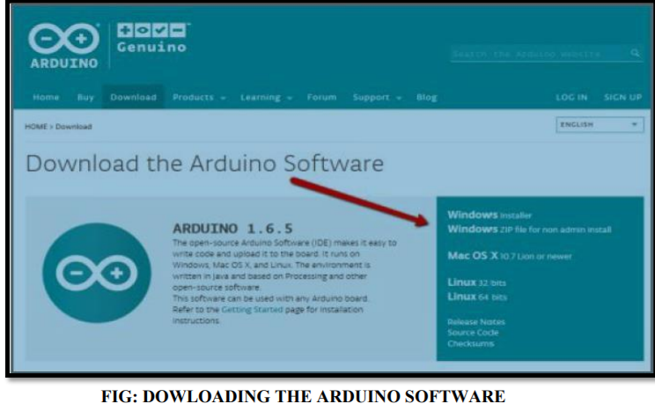
SOFTWARES USED
1.ARDUINO IDE:
A cross platform application comprising functions that are coded in Embedded C and C++. The programs are written and uploaded to Arduino boards using the IDE. In this system, the program is written in Embedded C for the working of the hardware components
It connects to the Arduino and Genuino hardware to upload programs and communicate with them. For this project we need three libraries
• AF MOTOR LIBRARY
• SERVO LIBRARY
• ULTASONIC LIBRARY

Slide 14
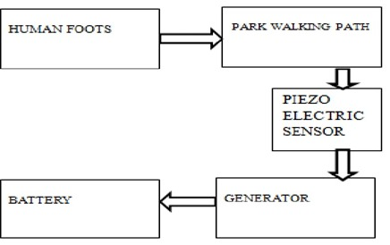
DESIGN
BLOCK DIAGRAM :

Slide 15
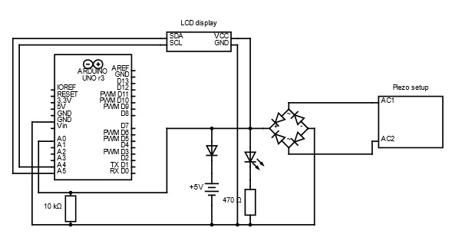
CIRCUIT DIAGRAM :

Slide 16
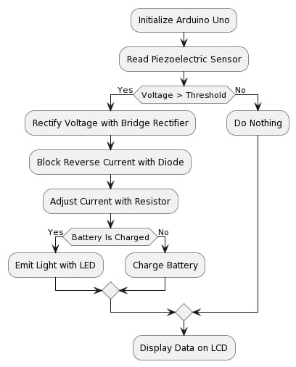
FLOW DIAGRAM :

Slide 17
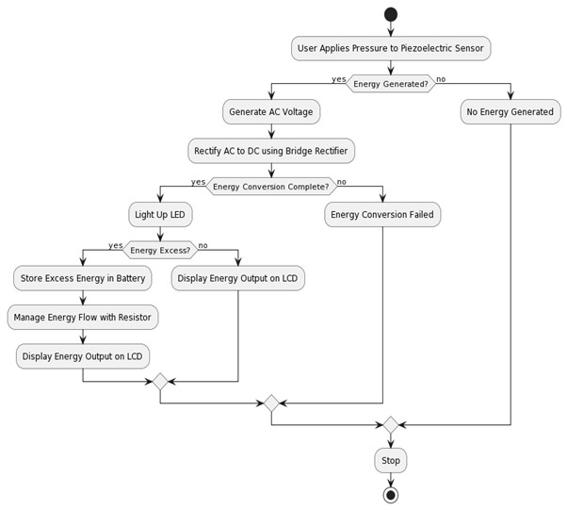
UML DIAGRAMS
ACTIVITY DIAGRAM :

Slide 18
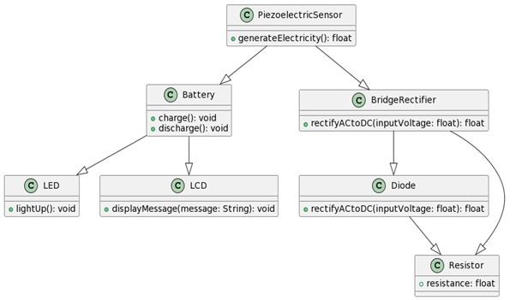
CLASS DIAGRAM :

Slide 19
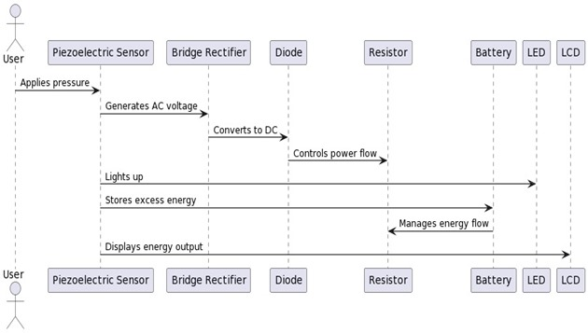
SEQUENCE DIAGRAM :

Slide 20
IMPLEMENTATION
Arrange piezoelectric sensors in parallel.
Connect the sensor array to the breadboard.
Implement a bridge rectifier for AC to DC conversion.
Integrate a diode for one-way current flow.Include a resistor for power flow management.
Connect an LED indicator for real-time energy conversion.
Incorporate a battery storage system for excess energy.
Connect an LCD screen via Arduino for voltage monitoring.

Slide 21
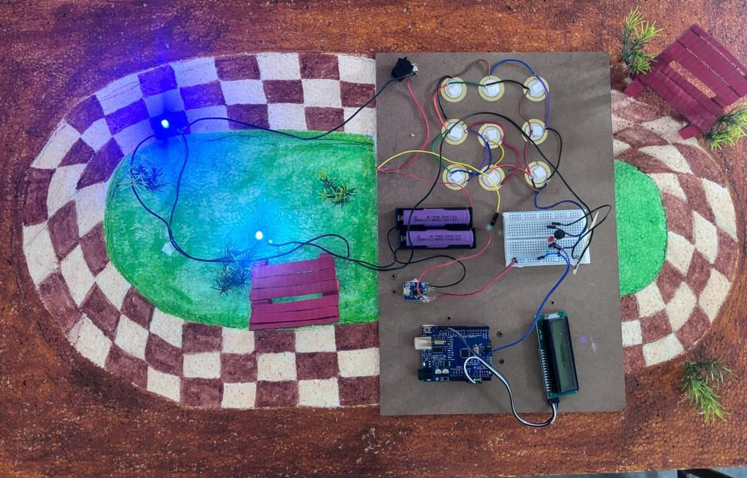
RESULT

Slide 22
CONCLUSION
The project work “FOOT STEP POWER GENERATION” is designed and developed successfully, for the demonstration purpose a proto type module is constructed with lower ratings of devices, & results are found to be satisfactory.
This concept falls under the subject of non-conventional energy resources, out of the many alternative energy resources one dependable source is solar energy, but it is quite costliest affair. Therefore alternative cheapest source is to generate electricity from foot step.
This technology proven here is the ultimate inexpensive source of all known forms of energy. When it is implemented practically, depending up on the size & traffic flow, each foot step may produce tens of kilowatts power every day, this power can be utilized for many applications.
If we are used this project at very busy stairs palace then we produce efficient useful electrical for large purposes. One important advantage of producing energy through this technology is that it does not pollute the environment.

Slide 23
THANK YOU…

